Slide 1

A project on Electrical Service Design
a presentation by
1706007 – Md. Rafiqul Islam Rafi
1706008 – Sheikh Munim Hussain
1706009 – Jahid Hasan Tushar
1706017 – Md. Jahidul Hoq Emon
1706020 – Shafin Shadman Ahmed
1706032 – Ayan Biswas Pranta
1706033 – Azazul Islam
Group No:
3

Slide 2
Why Electrical Service Design?
To create proper environment for productive work and comfortable life.
To provide benefits like energy supply, communication, ventilation, drainage system etc.
To assure emergency supply under outage situation.
To ensure appropriate protection in case any fault.
To make suitable accommodation irrespective of difficulty or age

Slide 3
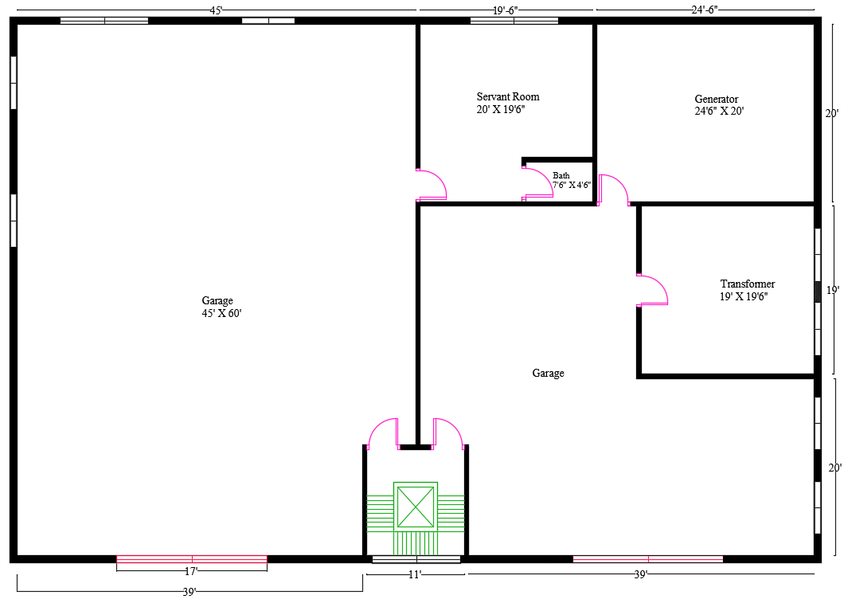
Floor Plan – Ground Floor

Slide 4
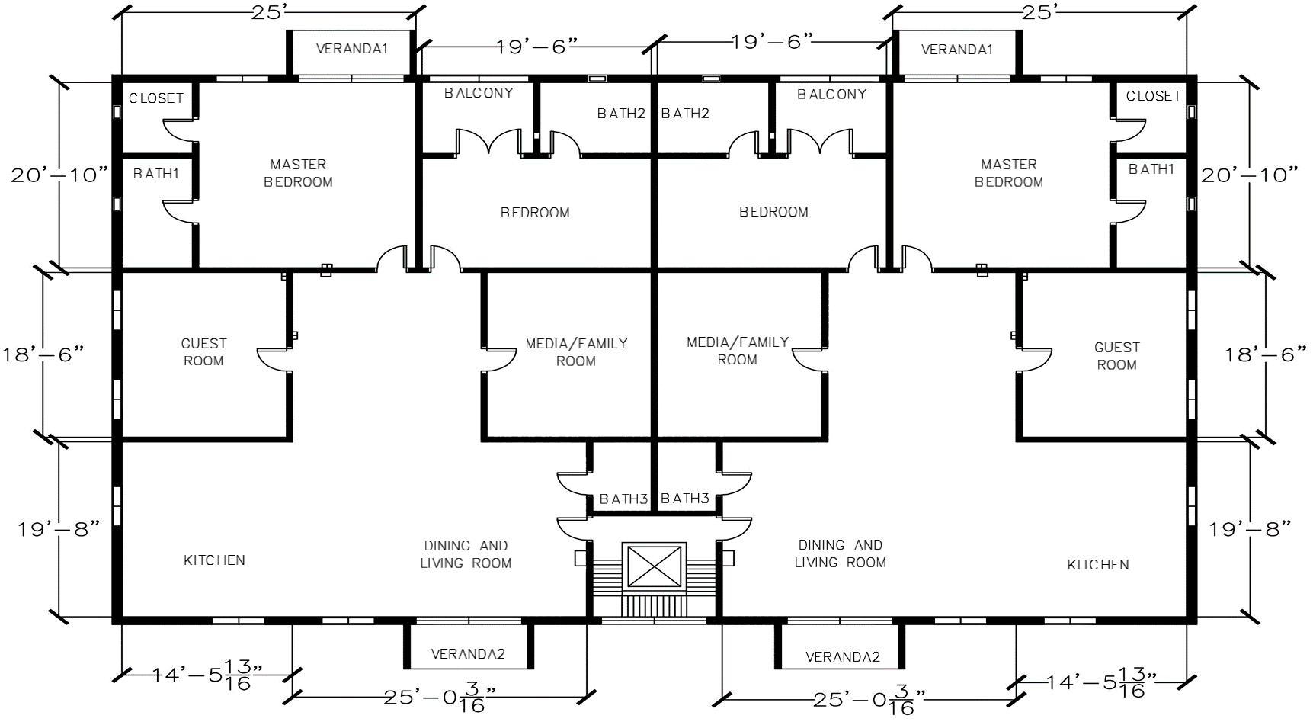
Floor Plan – Typical Floor

Slide 5
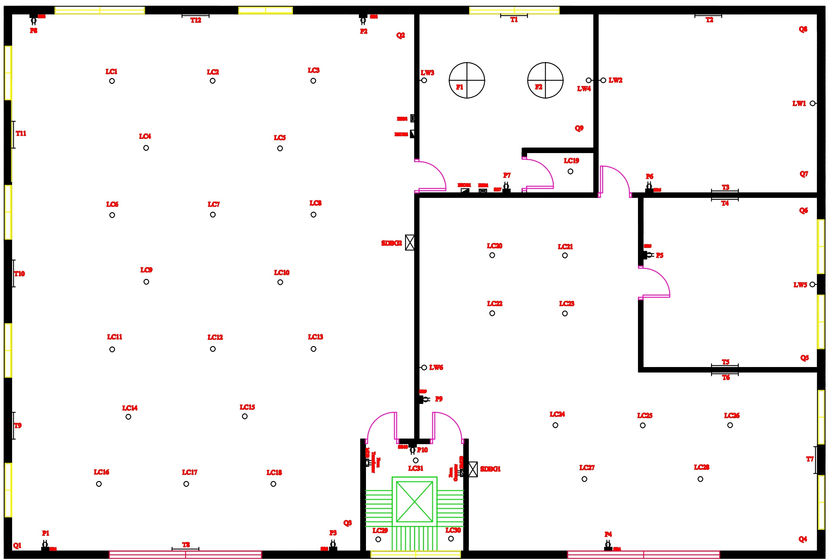
Fitting and Fixtures Layout – Ground Floor

Slide 6
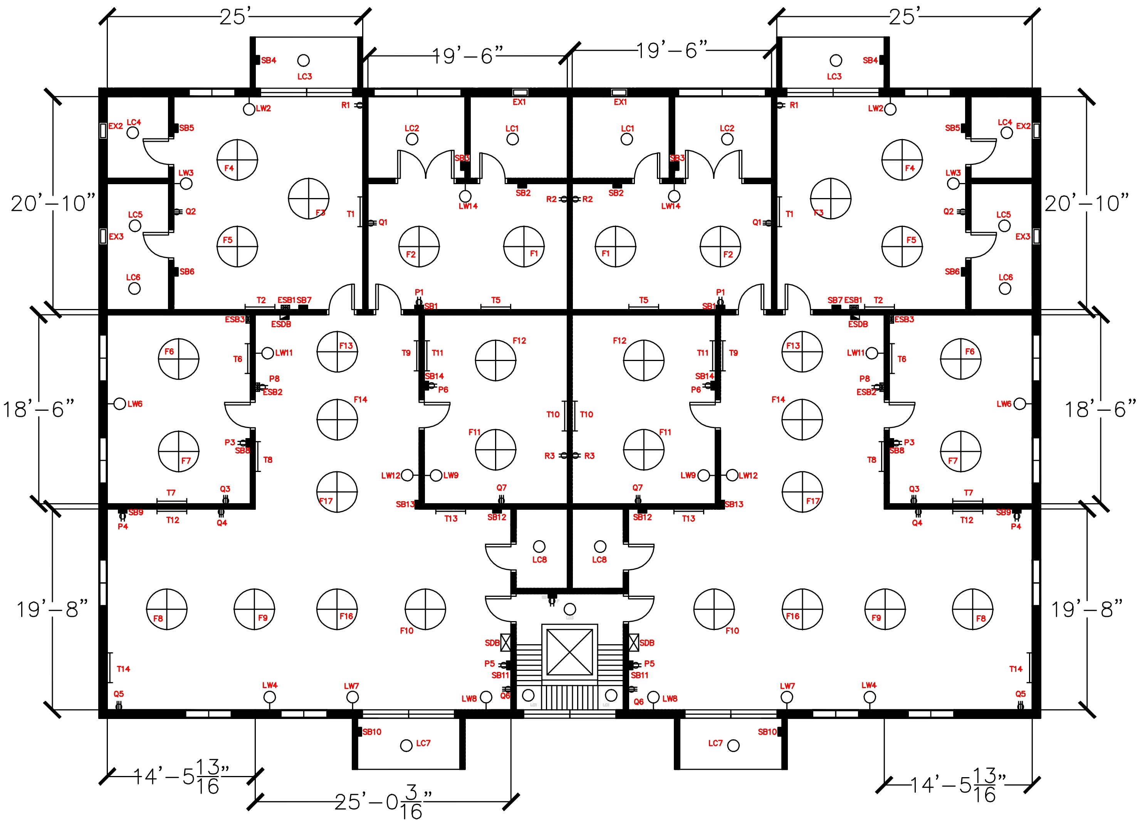
Fitting and Fixtures Layout – Typical Floor

Slide 7
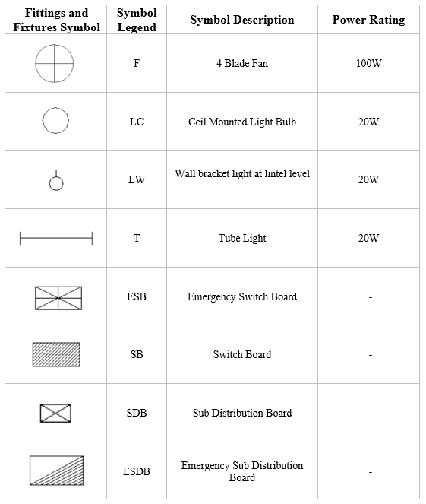
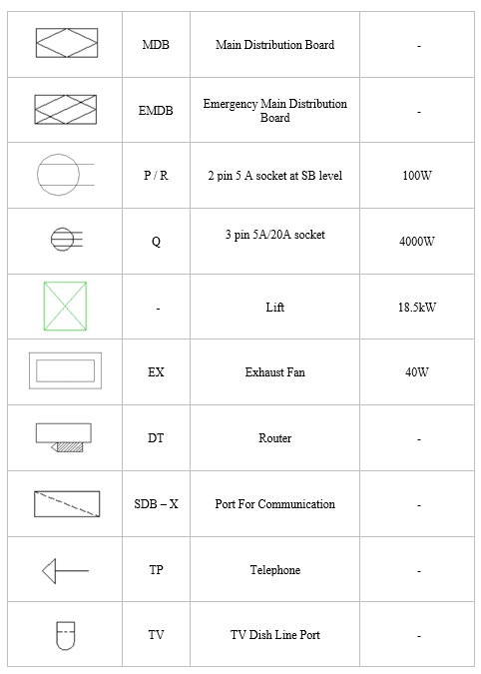
Electrical Appliances and Fixture / Fittings Schedule

Slide 8
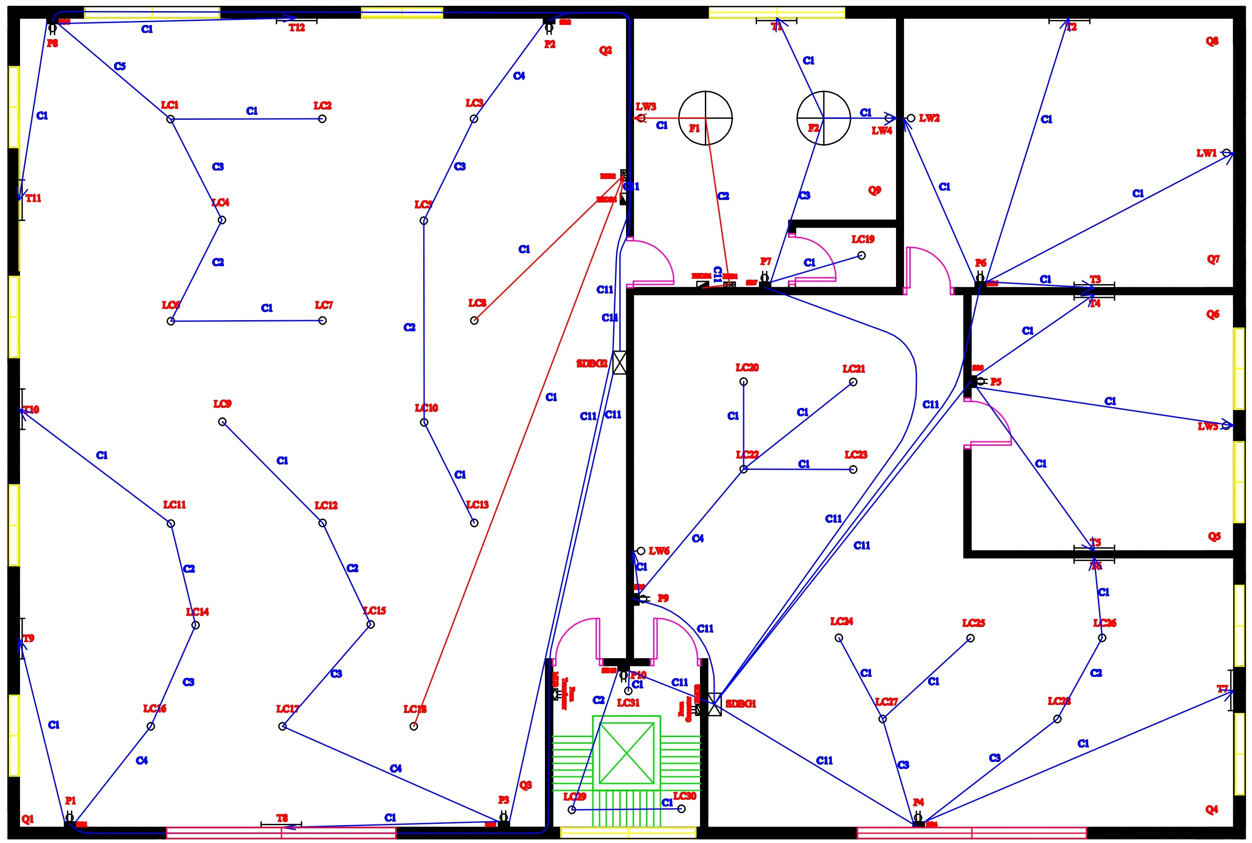
Conduit Layout – Ground Floor

Slide 9
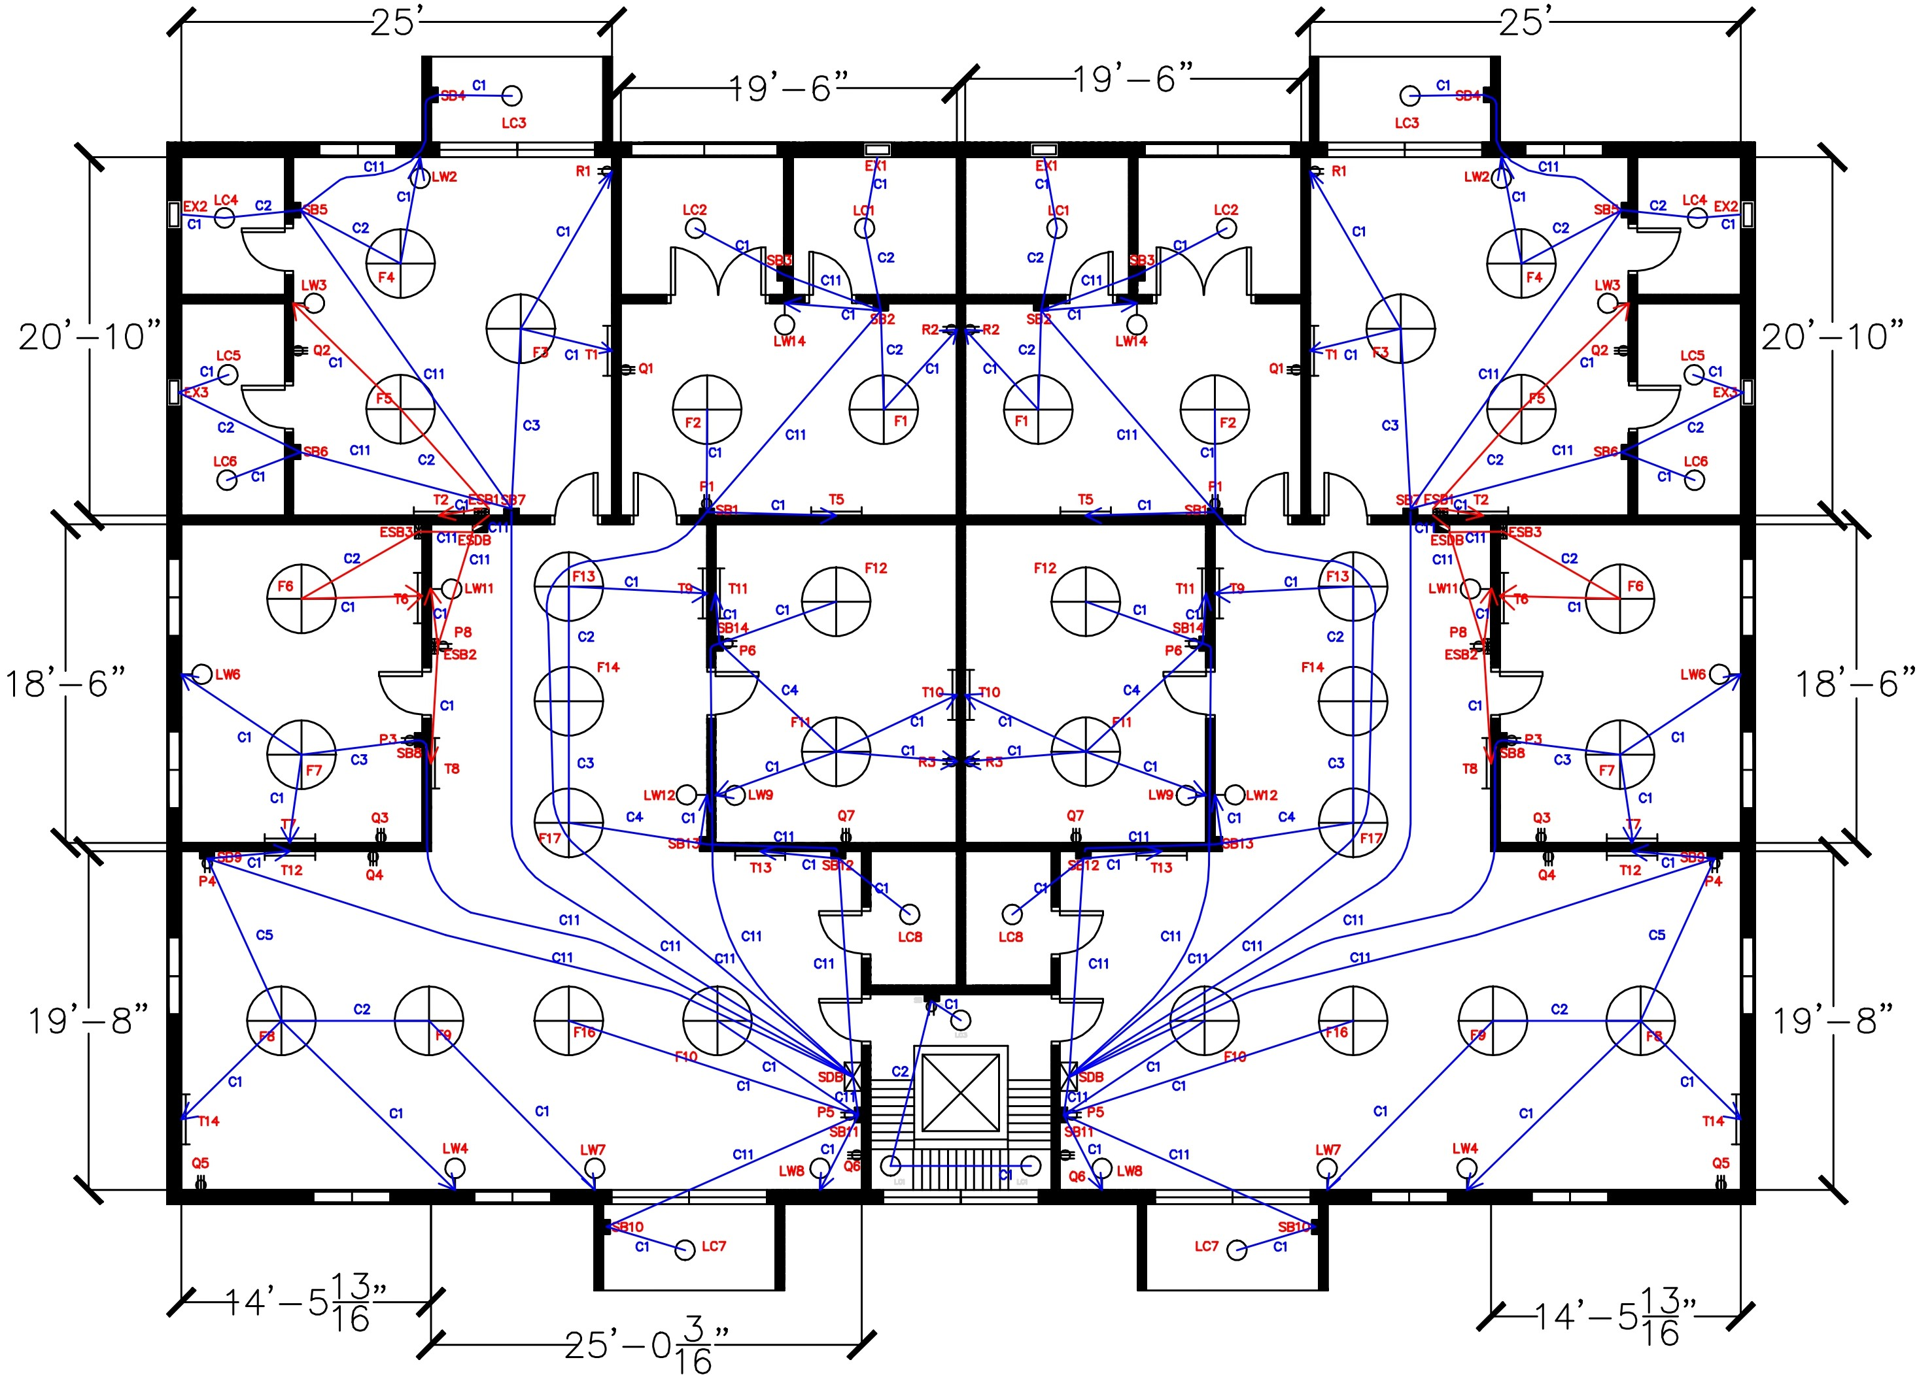
Conduit Layout – Typical Floor

Slide 10
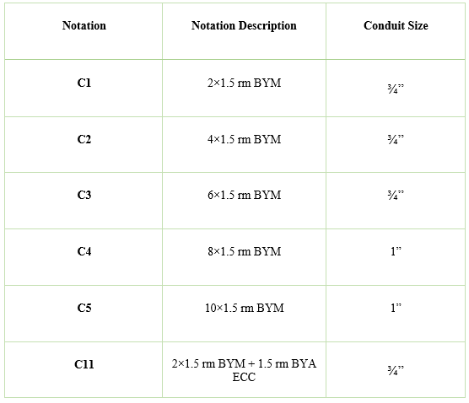
Conduit Schedule

Slide 11
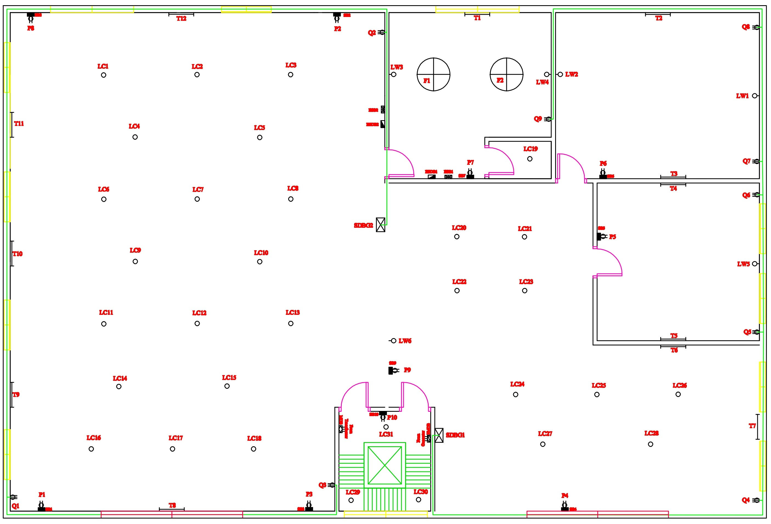
Power Socket Layout – Ground Floor

Slide 12
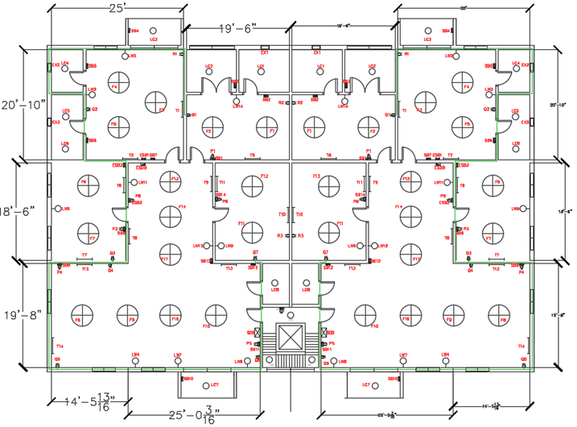
Power Socket Layout – Typical Floor

Slide 13
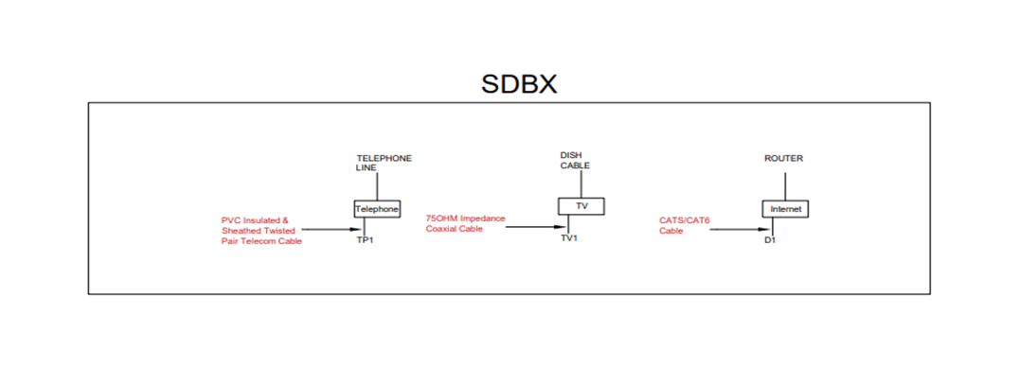
Conduit of TV, Telephone and Data Network

Slide 14
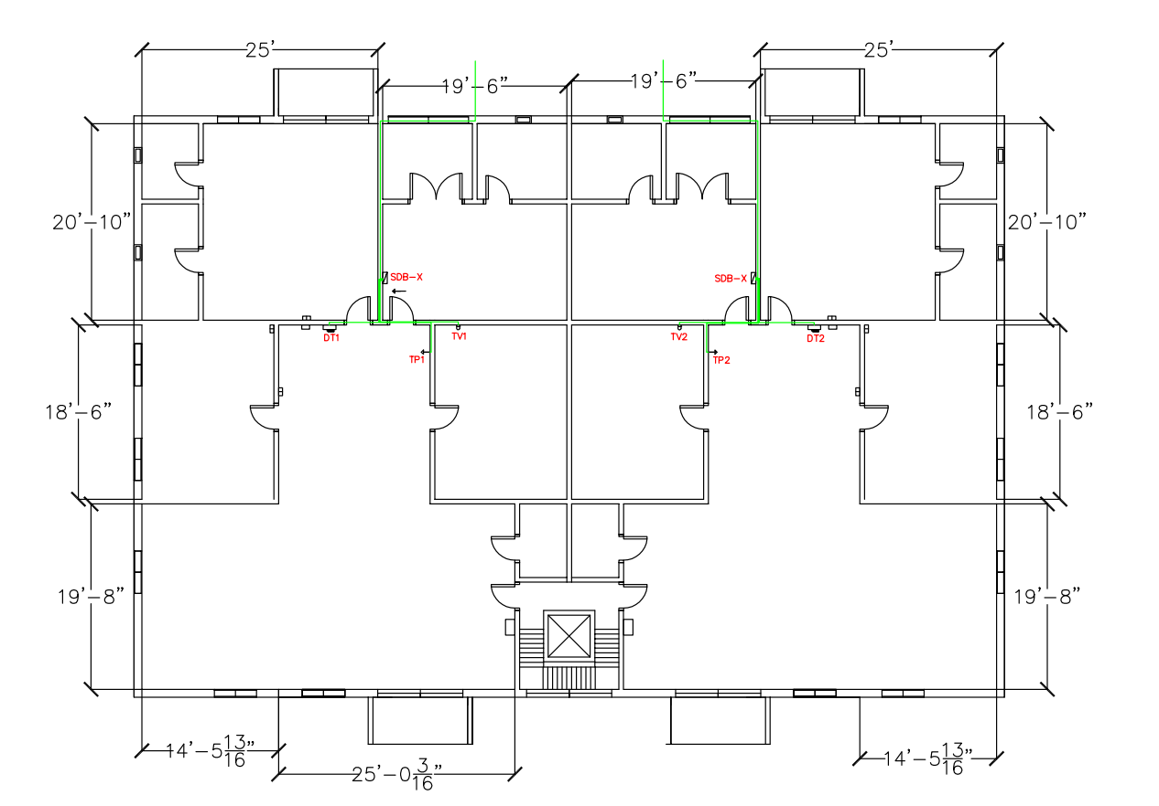
Conduit of TV, Telephone and Data Network

Slide 15
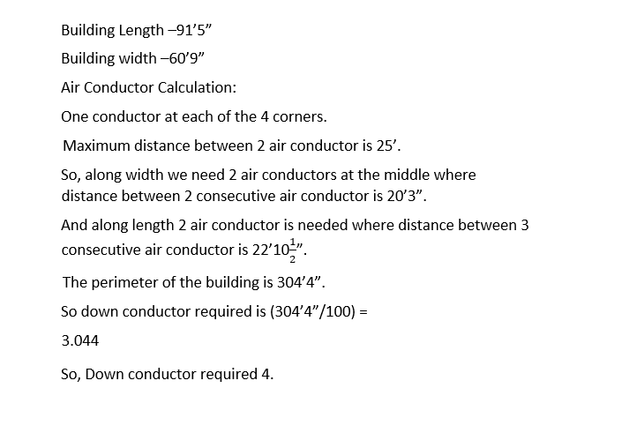
Calculation For Lightning Protection System

Slide 16
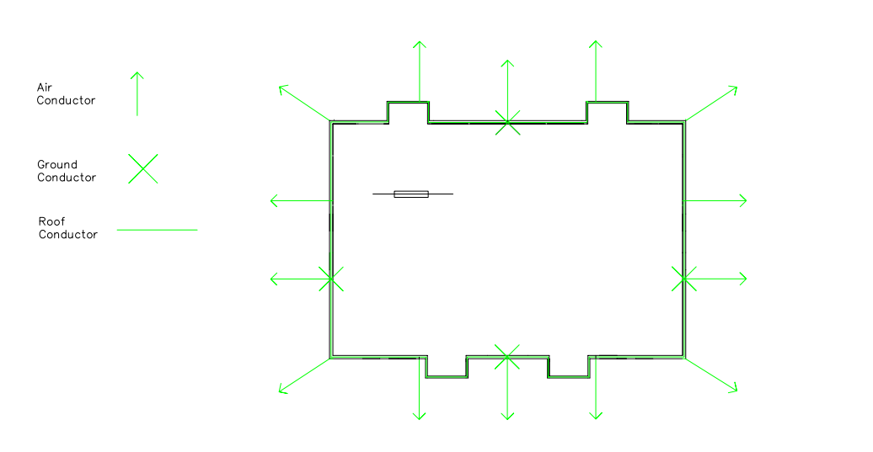
Lightning Protection System

Slide 17
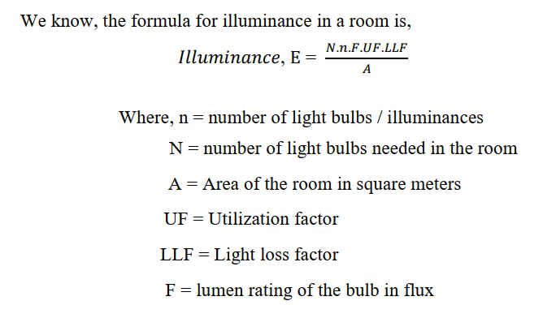
Calculation for Light Bulbs and Fans(Typical Floor)

Slide 18
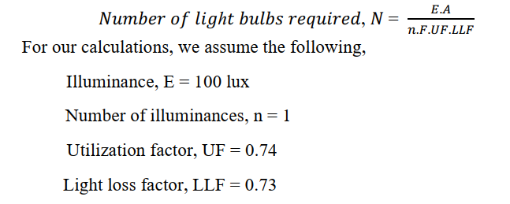
Calculation for Light Bulbs and Fans(Typical Floor Contd.)

Slide 19
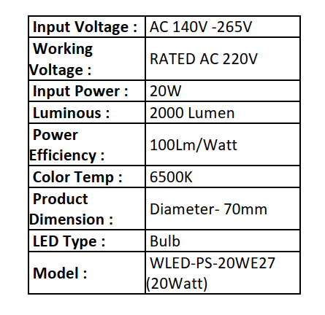

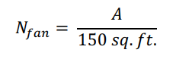
Calculation for Light Bulbs and Fans(Typical Floor Contd.)

Slide 20
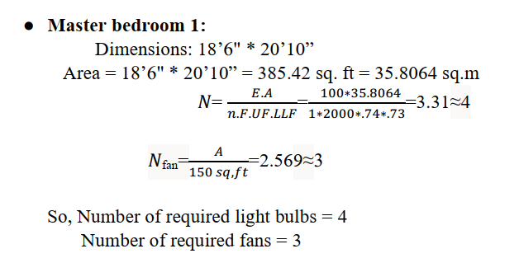
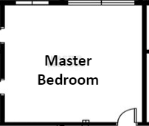
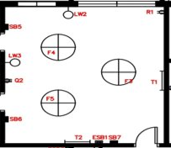
Calculation for Light Bulbs and Fans(Typical Floor Contd.)

Slide 21
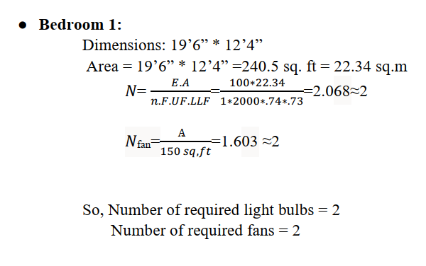
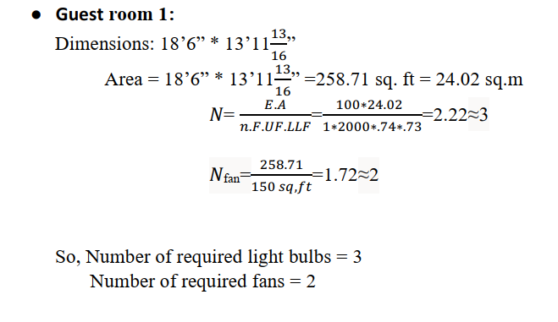
Calculation for Light Bulbs and Fans(Typical Floor Contd.)

Slide 22
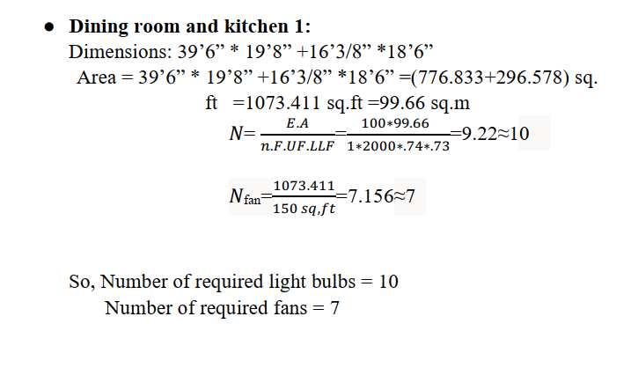
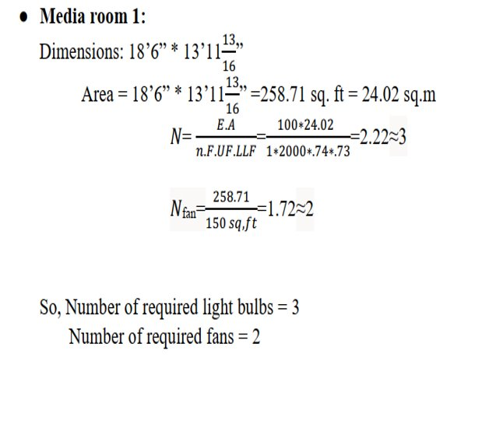
Calculation for Light Bulbs and Fans(Typical Floor Contd.)

Slide 23
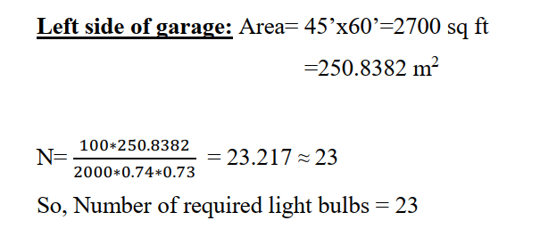
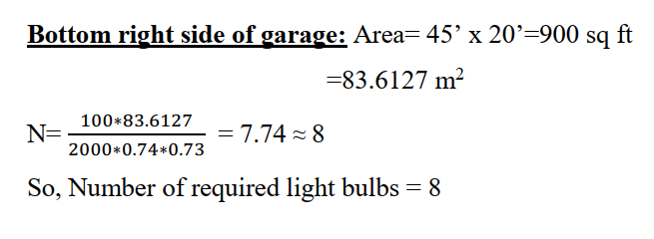
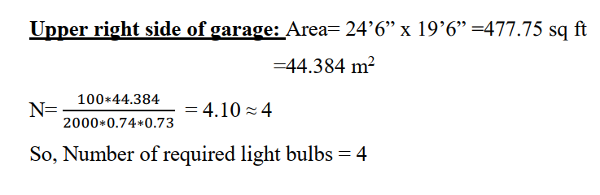
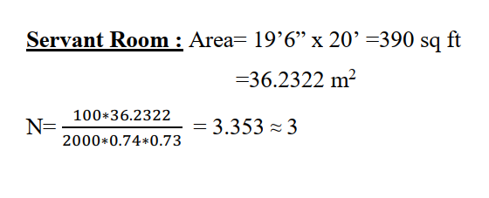
Calculation for Light Bulbs and Fans(Ground Floor)

Slide 24
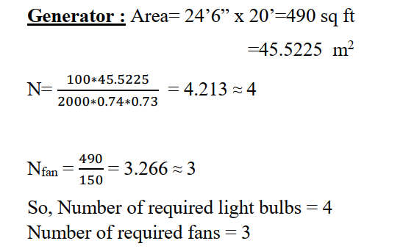
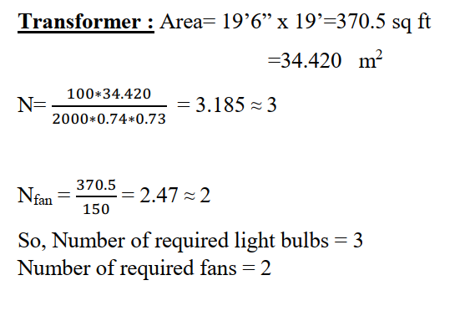
Calculation for Light Bulbs and Fans(Ground Floor Contd.)

Slide 25
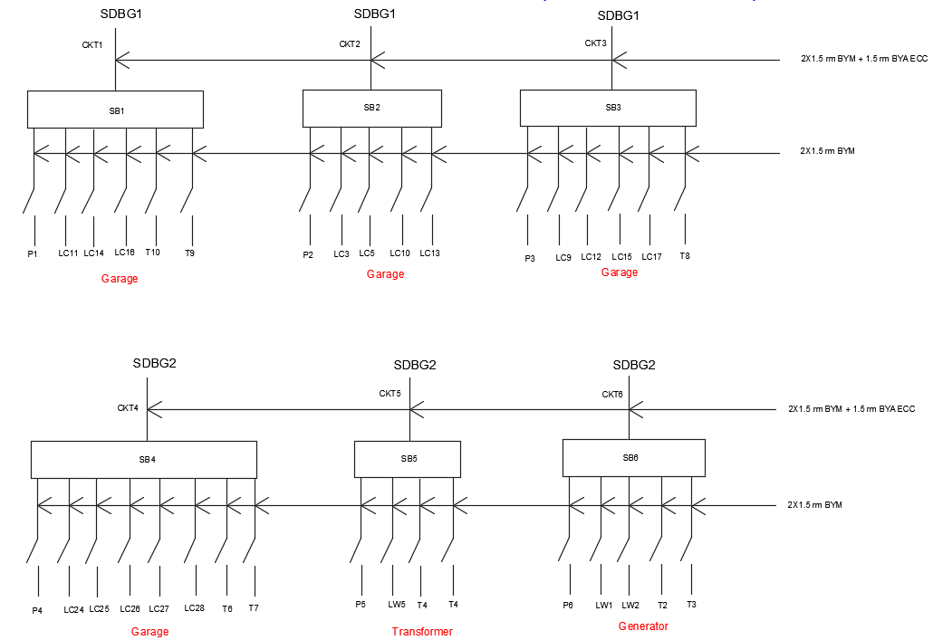
Switch Board Connection Diagram – Ground Floor

Slide 26
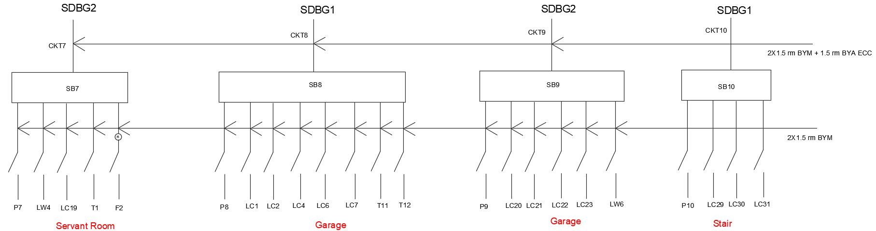
Switch Board Connection Diagram – Ground Floor (Contd..)

Slide 27
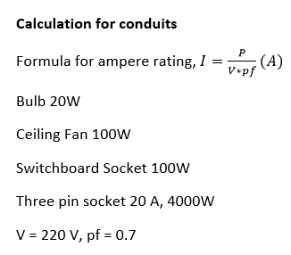
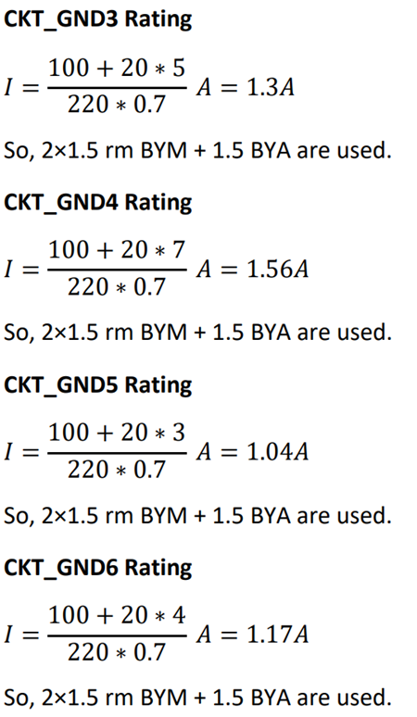
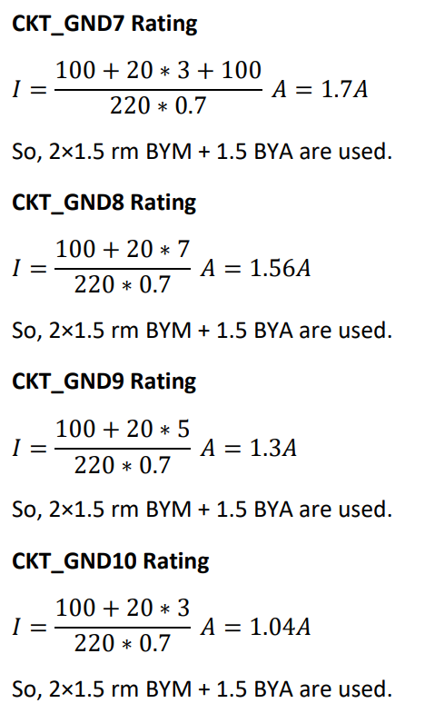
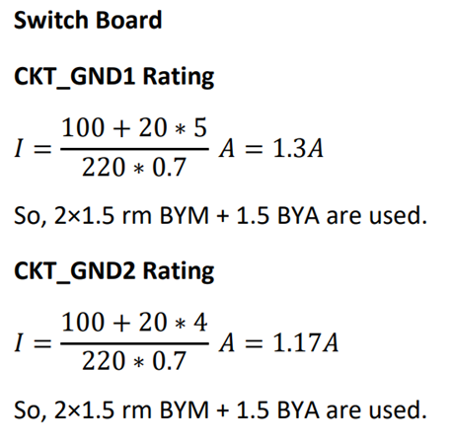
Switch Board Connection Diagram – Ground Floor – Calculation ​

Slide 28
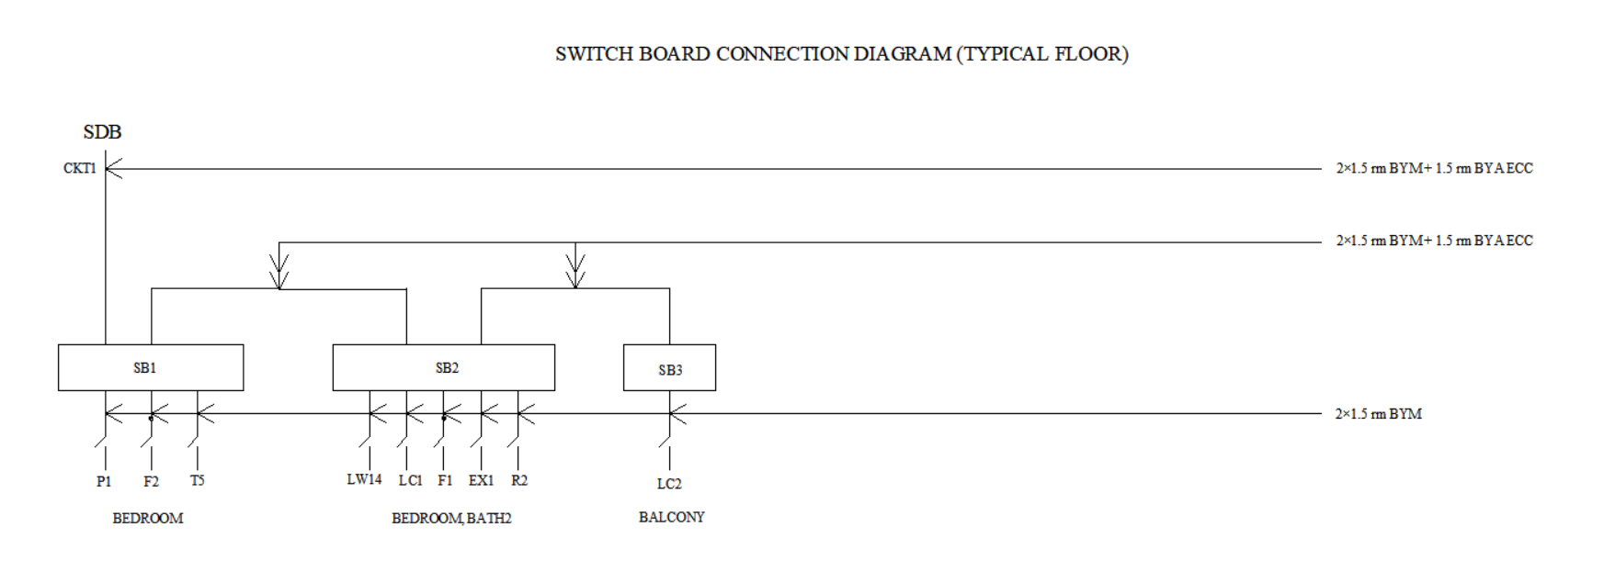
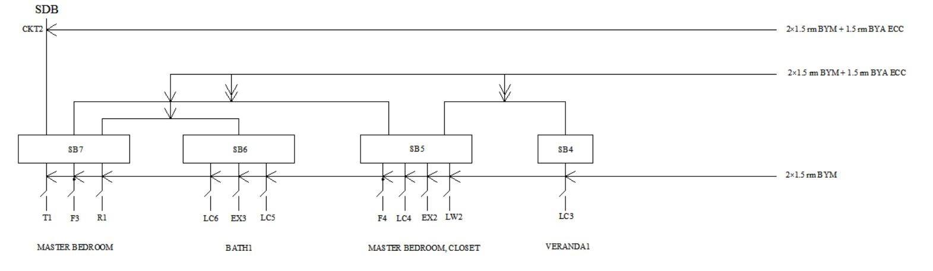
Switch Board Connection Diagram – Typical Floor

Slide 29
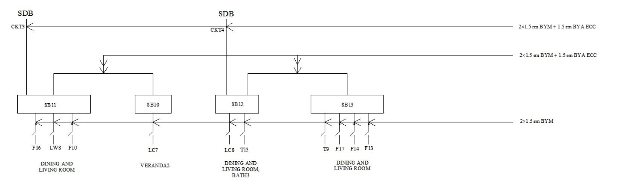
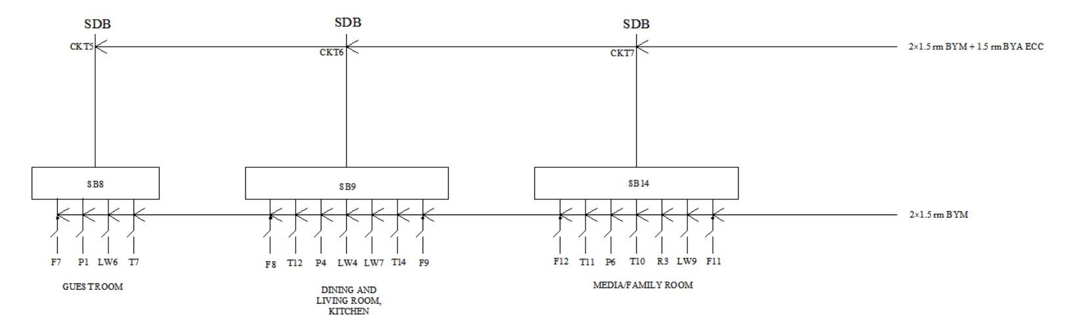
Switch Board Connection Diagram – Typical Floor (Cont..)

Slide 30
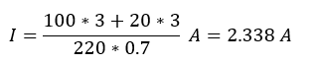
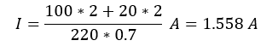
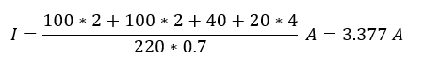
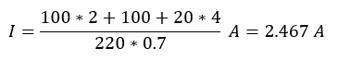
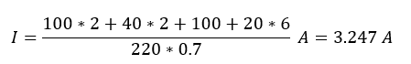
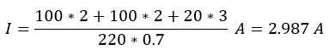
Switch Board Connection Diagram – Typical Floor – Calculation
Formula for ampere rating, All Lights: 20 W, Ceiling Fan: 100 W, Exhaust Fan: 40 W, Switchboard Sockets: 100 W, 3-pin Sockets: 20 A/4000 W, V = 220 V, pf = 0.7 Typical Floor Switch Board CKT1 Rating So, 2×1.5 rm BYM + 1.5 BYA are used. CKT2 Rating So, 2×1.5 rm BYM + 1.5 BYA are used. CKT3 Rating So, 2×1.5 rm BYM + 1.5 BYA are used. | CKT4 Rating So, 2×1.5 rm BYM + 1.5 BYA are used. CKT5 Rating So, 2×1.5 rm BYM + 1.5 BYA are used. CKT6 Rating So, 2×1.5 rm BYM + 1.5 BYA are used. CKT7 Rating So, 2×1.5 rm BYM + 1.5 BYA are used.

Slide 31
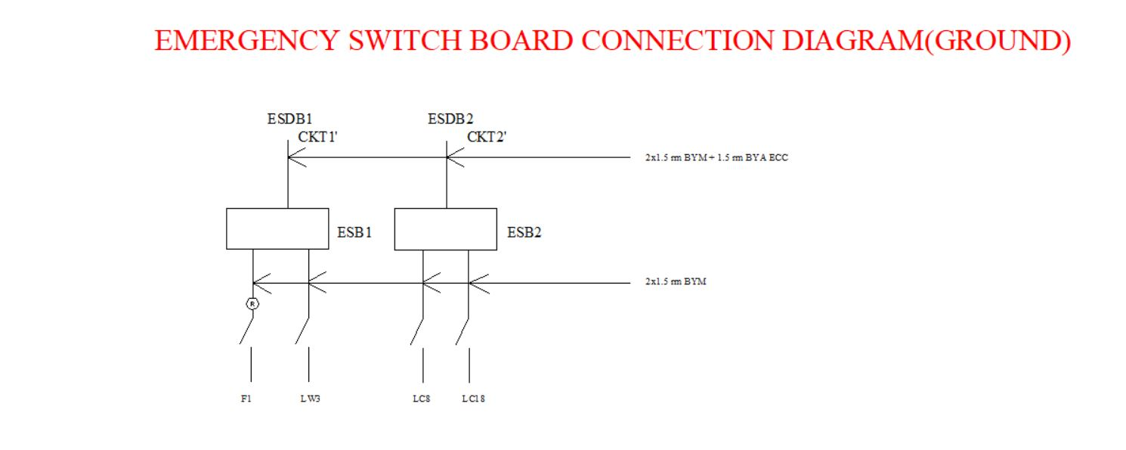
Emergency Switch Board Connection Diagram – Ground Floor

Slide 32
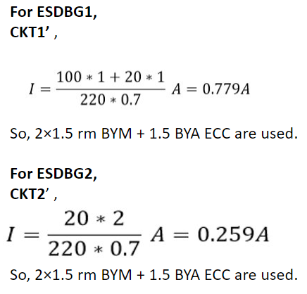
Emergency Switch Board Connection Diagram – Ground Floor - Calculation

Slide 33

Emergency Switch Board Connection Diagram – Typical Floor

Slide 34


Emergency Switch Board Connection Diagram – Typical Floor - Calculation
CKT1’ Rating
$$I=\frac{100+20∗2}{220∗0.7} A=0.909A$$
So, 2×1.5 rm BYM + 1.5 BYA are used.
CKT2’ Rating
$$I=\frac{100+20∗2}{220∗0.7} A=0.909A$$
So, 2×1.5 rm BYM + 1.5 BYA are used.
CKT3’ Rating
$$I=\frac{100+20}{220∗0.7} A=0.779A$$
So, 2×1.5 rm BYM + 1.5 BYA are used.
Formula for ampere rating, $I=\frac{P}{V∗pf}(A)$
Bulb 20W
Ceiling Fan 100W
Switchboard Socket 100W
Three pin socket 20 A, 4000W
V = 220 V, pf = 0.7

Slide 35

Sub Distribution Board(SDB) Diagram – Ground Floor

Slide 36

Sub Distribution Board(SDB) Diagram – Ground Floor

Slide 37


Sub Distribution Board(SDB) Diagram – Ground Floor – Calculation

Slide 38

Sub Distribution Board(SDB) Diagram – Typical Floor

Slide 39


Sub Distribution Board(SDB) Diagram – Typical Floor – Calculation
Total SDB Load = Total load from CKTs × 0.7 + Total Power Socket Load × 0.2 Total load from CKTs = CKT1 Load + CKT2 Load + CKT3 Load + CKT4 Load + CKT5 Load + CKT6 Load + CKT7 Load SDB Current = , Power Socket Load = 4000 W, Voltage = 220 V, Power Factor = 0.7 CKT1 Load = (100 * 2 + 100 * 2 + 40 + 20 * 4) W = 520 W CKT2 Load = (100 * 2 + 100 + 40 * 2 + 20 * 6) W = 500 W CKT3 Load = (100 * 2 + 20 * 2) W = 240 W CKT4 Load = (100 * 3 + 20 * 3) W = 360 W CKT5 Load = (100 * 2 + 20 * 2) W = 240 W CKT6 Load = (100 * 2 + 100 + 20 * 4) W = 380 W CKT7 Load = (100 * 2 + 100 * 2 + 20 * 3) W = 460 W Total load from CKTs = 2700 W Total Load From Power Socket = 4000 W * 6 = 24000 W SDB Load = 2700 * 0.7 + 24000 * 0.2 = 6690 W SDB Current = A = 43.442 A So, 50 A SP MCCB is needed from SDB to MDB and 2 × 25 rm BYM + 25 BYA are used.

Slide 40

Emergency Sub Distribution Board(ESDB) Diagram – Ground Floor

Slide 41


Emergency Sub Distribution Board(ESDB) Diagram – Ground Floor – Calculation
In ESDBG1,
pf = 0.7
Total load = (100+20)*0.7= 84 W
So, 5A SP MCCB is needed from ESDBG1 to EMDB & 2×1.5 rm BYM + 1.5 BYA ECC are used.
In ESDBG2,
pf = 0.7
Total load = 40 * 0.7 =28 W
So, 5A SP MCCB is needed ESDBG2 to EMDB & 2×1.5 rm BYM + 1.5 BYA ECC are used.

Slide 42

Emergency Sub Distribution Board(ESDB) Diagram – Typical Floor

Slide 43


Emergency Sub Distribution Board(ESDB) Diagram – Typical Floor – Calculation
Total ESDB Load = Total load from CKTs x 0.7 + Total Power Socket Load x 0.2
Total load from CKTs = CKT1’ Load + CKT2’ Load + CKT3’ Load
ESDB Current = $\frac{Total ESDB Load }{Voltage ×pf}$
Power Socket Load = 4000W
Voltage = 220V
Power Factor = 0.7
CKT1’ Load = $100+20∗2$ = 140W
CKT2' Load = $100+20∗2$ = 140W
CKT3’ Load = $100+20$ = 120W
Total load from CKTs = 400 W
Total Load From Power Socket = 4000W
ESDB Load = 400 * 0.7 + 4000 * 0.2 = 1080 W
ESDB Current = $\frac{1080}{220×0.7}=7.013A$
So, 10A SP MCCB is needed from ESDB to EMDB.
But, Q3 has a current rating more than this range. So, a 30A SP MCCB is used from ESDB to EMDB.

Slide 44

Emergency Main Distribution Board Diagram

Slide 45

MDB

Slide 46


Calculations for MDB and EMDB

Slide 47

Calculations for MDB and EMDB

Slide 48

Reference

Slide 49

Acknowledgement
Special thanks to honorable Yeasir Arafat Sir for giving us an opportunity to present our project and enhancing our knowledge and experience in the field of Electrical Systems Designing.

Slide 50

Acknowledgement
Also, a ton of thanks goes to honorable Ashiqur Rasul Sir for helping us to gain knowledge about CAD and how to use it for ESD drawings. Without his advice, our project couldn't have probably come this far.

Slide 51
Thank You

